Slide 1

Online learning application project presentation academic year 2022/2023
Prof. Gatti Nicola
Awad Joy
Behrens Francesca
Caresana Silvia
El Khoury Jana

Slide 2

Scenario
E – commerce website which sells alcoholic beverages
Three different classes of users, identified by two binary features, that behave in a different way
Product displayed one at a time

Slide 3

E – commerce structure
PHASE 1
PHASE 2
PHASE 3
PHASE 4
DISPLAY
PURCHASE
RECCOMENDATION
SELECTION
The primary product is displayed with its price to the website user
The user decides to buy a certain number of items of the primary product
Two secondary products are recommended with the price hidden
The user selects one of the secondary products, and then a new tab is open with that product as primary

Slide 4
Step 1: Environment

Slide 5
Step 1
In this steps the environment is provided, that is the configuration of the website and the simulator

Slide 6

Products
We focused on this five products to give a simple representation of how the website works:
        Wine (medium quality)
        Wine (high quality)
        Limoncello
        Gin
        Whisky
20 €

Slide 7
Products
For every product there are four possible prices, and the price can be changed at most once a day. These prices are stored in a matrix of dimensions #products x #prices
Every price is associated to a known margin, and they are stored in a matrix too
The conversion rates of every product depends on the chosen price, and these are unknown quantities
Wine (€)
Wine (€€€)
Limoncello
Gin
Whisky
4 €
6 €
9 €
13 €
49 €
53 €
59 €
64 €
8 €
12 €
18 €
25 €
29 €
36 €
50 €
57 €
33 €
38 €
45 €
49 €

Slide 8





Products
After the purchase of a product, two other products are recommended
The primary product has probability 1 to be seen, while the secondary product has probability λ = 0.75
The secondary products displayed are known and are determined from this graph.
Wine(€)
Gin
Wine (€€€)
Limoncello
Whisky

Slide 9

User classes
Two different features identify three user classes:
The users belonging to different classes are different since every class represents a different behaviour; the distribution of the number of users is also different among the classes

Slide 10




User classes
College students: mainly interested in purchasing cheap alcohol for their parties.
Very interested in: cheap wine, gin
Not so interested in: expensive wine
Male adults: enjoy quality drinks and have dinner with a fine wine bottle.
Very interested in: expensive wine, gin, whisky
Not so interested in: cheap wine
Female adults: like to do aperitivo with friends and sometimes drink limoncello.
Very interested in: expensive wine, limoncello
Not so interested in: cheap wine, whisky

Slide 11
User classes
The user classes are introduced to underline different behaviour of potential different users.
The users may differ in term of:
  The mean number of products sold, according to their needs
  The conversion rate, i.e. the probability that a user would buy a certain product given the price
  The 𝛼 ratios, that are the probabilities to land the webpage that displays a certain product, and the probability not to land on any of them
  The graph probabilities, i.e. the probability to go from one product webpage to another one
  The mean daily number of users visiting the website. Users distributions:

Slide 12
Simulation
A random number is assigned for the number of daily users, for each class, according to the distributions
For every user, the vector of alpha probabilities determines the page that the user will see first
The user buys or not the primary product according to the conversion rates
The number of items sold per buyers is determined by a Poisson distribution, whose parameters are different for every user class and stored in an array
Graph probability determines the probability of clicking on a secondary product; once another product has been visited it won’t be visited again
This is repeated for every new primary product, and the series of webpages is saved
Bruteforce approach is used as reference to compare the optimal reward with the ones found

Slide 13
Step 2: Optimization algorithm

Slide 14
Step 2
In this step a greedy algorithm is designed to maximize the cumulative expected margin over all the products

Slide 15
Greedy algorithm
A greedy algorithm is designed in order to find the best price configuration:
  Set the price configuration with the lowest price for every product
  Compute the total expected reward and save it as reference value
  Increment one price at a time (if we are not already considering the highest one)
  Compute the total expected reward of every new price configuration
  Select the price configuration whose reward is higher than the others and than the reference value
  Set the new reference value with the one selected in step 5
  Iterate steps from 3 to 6, until is found no total expected reward higher than the reference one, and break the algorithm
  Return the best price configuration with the associated total reward.

Slide 16
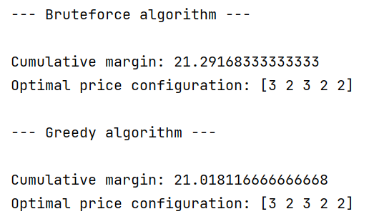
Greedy algorithm
The price configuration found by the greedy algorithm and the bruteforce is the same
The obtained revenues are slightly different, due to the random sampling in the simulation
Since the greedy algorithm stops in local maxima, it can lead to a different price configuration (this depends on the parameters chosen in the configuration file)

Slide 17
Step 3: Optimization with uncertain conversion rates

Slide 18
Step 3
The step aims at optimizing the total reward by implementing TS and UCB algorithm for uncertain conversion rates

Slide 19
UCB
We associate every product with a UCB learner; every price corresponds to an arm
We estimate the conversion rate, computed as the weighted average of the ratio between buyers and viewers, and used this as the empirical mean
The steps are as follows:
  We compute the upper confidence as the sum of the empirical mean and the confidence, for each price, each day
  Select the arm that maximizes this value:
  Once the prices (arm) are selected we run the simulation with the configuration
  Then, the confidence is updated as follows:

Slide 20
TS
We associate every product with a TS learner; every price corresponds to an arm
We define beta parameters from a distribution, with their means being the estimated conversion rates
The steps are as follows:
  We draw a sample from a beta distribution for each price, each day
  Select the arm that maximizes the value
  Once the prices (arm) are selected we run the simulation with the configuration
  Then, the parameters of the beta are updated as follows:

Slide 21
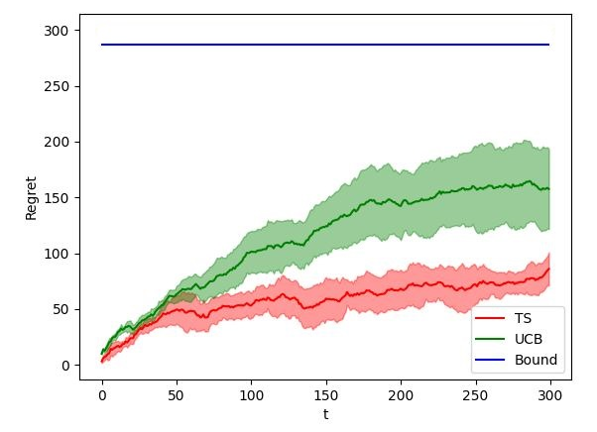
Results
Plot of the cumulative regret of TS and UCB, in a time horizon of T = 300
Mean over 5 experiments
The theoretical bound of UCB is plotted, and it’s computed as
Sublinear behaviour for both learners
The cumulative regret of TS is generally lower than the one of UCB, so it is performing better

Slide 22
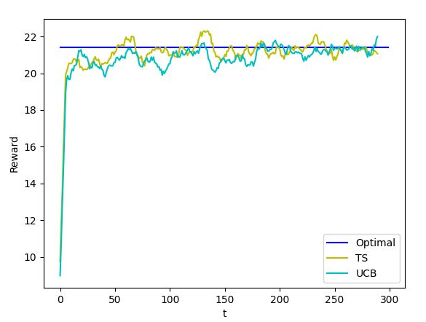
Results
Plot of the daily rewards, according to the prices chosen by the algorithms, in a time horizon of T = 300
Mean over 5 experiments
Both the algorithm are converging to the best solution
The mean optimal reward given by the bruteforce algorithm is plotted

Slide 23
Step 4: Optimization with uncertain conversion rates, 𝛼 ratios, and number of items sold per product

Slide 24
Step 4
The step aims at optimizing the total reward by implementing TS and UCB algorithm for uncertain conversion rates, α ratios and number of sold items

Slide 25
UCB
We associate every product with a UCB learner; every price corresponds to an arm
We estimate the conversion rate, computed as the weighted average of the ratio between buyers and viewers, and used this as the empirical mean
The steps are as follows:
  We compute the upper confidence as the sum of the empirical mean and the confidence, for each price, each day
  Select the arm that maximizes this value:
  Once the prices (arm) are selected we run the simulation with the configuration
  Then, the confidence is updated as follows:
  Finally we updated the estimated number of sold items and alphas

Slide 26
TS
We associate every product with a TS learner; every price corresponds to an arm
We define beta parameters from a distribution, with their means being the estimated conversion rates
The steps are as follows:
  We draw a sample from a beta distribution (b) for each price, each day
  Select the arm that maximizes this value:
  Once the prices (arm) are selected we run the simulation with the configuration
  Then, the parameters of the beta are updated as follows:
  finally we updated the estimated number of sold items and alphas

Slide 27
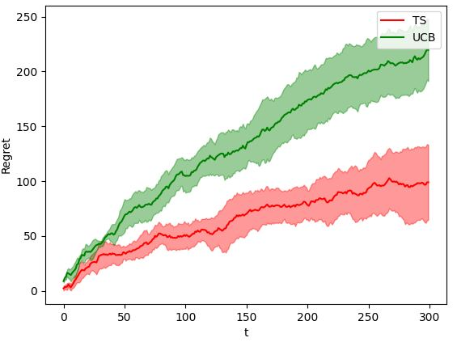
Results
Plot of the cumulative regret of TS and UCB, in a time horizon of T = 300
Mean over 5 experiments
Same behaviour as in step 3
TS regret is generally lower than UCB regret

Slide 28
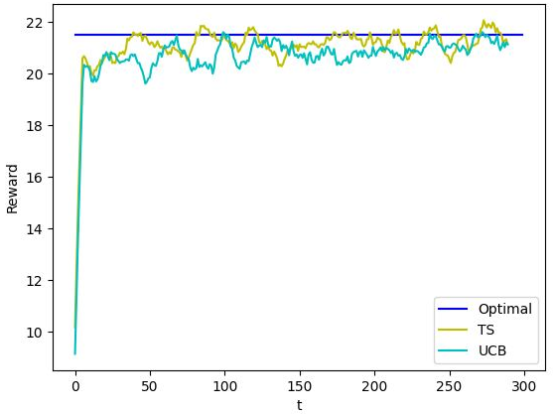
Results
Plot of the daily rewards, according to the prices chosen by the algorithm, in a time horizon of T = 300
Mean over 5 experiments
Both the algorithm are converging to the best solution
The mean optimal reward given by the bruteforce algorithm is plotted

Slide 29
Step 5: Optimization with uncertain graph weights

Slide 30
Step 5
The step aims at optimizing the total reward by implementing TS and UCB algorithm for uncertain conversion rates and graph weights

Slide 31
Montecarlo sampling
We computed a Montecarlo sampling to estimate the graph probabilities
For each product the graph probability that a user clicks on a secondary product while viewing product is computed at the end of each day as follows:
, where

Slide 32
Learner
We associate every product with a learner; every price corresponds to an arm
The steps are as follows:
  For each day, select the arm that maximizes this value:
  where is the probability of going from product to
  Once the prices (arm) are selected we run the simulation with the configuration computed by the learners
  Finally we updated the estimated graph probabilities

Slide 33
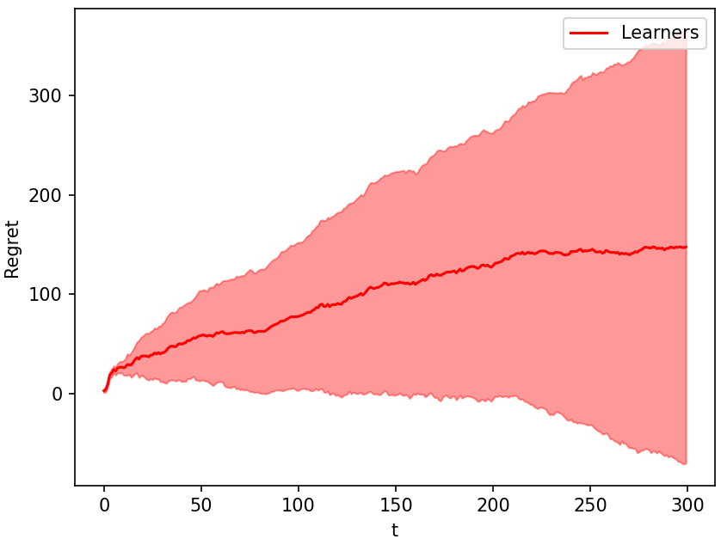
Results
Plot of the cumulative regret of the described algorithm, in a time horizon of T = 300
Mean over 5 experiments
Sublinear behaviour
The large confidence interval is due to the fact that the estimated probability are strictly related to the simulation runned

Slide 34
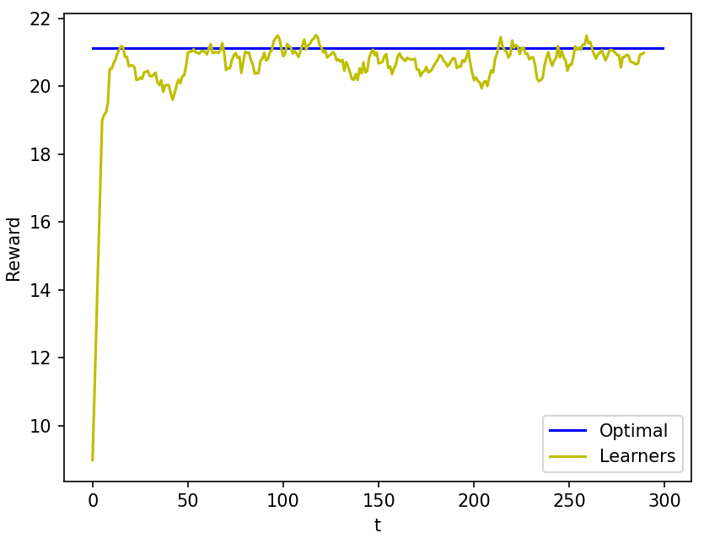
Results
Plot of the daily reward, according to the prices chosen by the learner, in a time horizon of T = 300
Mean over 5 experiments
The algorithm converges to the optimal computed very rapidly

Slide 35
Step 6: Non – stationary demand curve

Slide 36
Step 6
In this step we face the scenario where the demand curve is subject to abrupt changes
We compared two approaches: UCB with change detection and UCB with sliding window

Slide 37
Phases
The abrupt changes generates different phases
Three phases, lasting 150 day each:
  Phase 1: the configuration is the same of previous steps
  Phase 2: due to an increase of the alcoholic taxes decided by the Italian government, all the prices of the products increased by 20%, and consequently the conversion rates drop by 30%
  Phase 3: some products costs increased, and prices consequently increase by 5%
For each phase, the optimal is computed

Slide 38
UCB – Change detection (CD)
We associate every product with a CD learner; every price corresponds to an arm
Cumulative sum test (CUSUM) is used to monitor change detection
We estimate the conversion rate, computed as the weighted average of the ratio between buyers and viewers, and used this as the empirical mean
The algorithm works like UCB but when a significant difference in empirical mean*margin is detected, it restarts to learn
We define:
  sample at time t, and the empirical mean
  and the positive and negative deviation from the mean
  and the cumulative positive and negative deviation from the mean
  The change is detected when or , where is the threshold

Slide 39
UCB – Sliding window (SW)
We associate every product with a SW learner; every price corresponds to an arm
Window size is the number of samples in the window and it’s fixed to 20
We estimate the conversion rate, computed as the weighted average of the ratio between buyers and viewers, and used this as the empirical mean
The confidence considered is the standard confidence of UCB
The algorithm works like UCB, but considering only the samples in the window

Slide 40
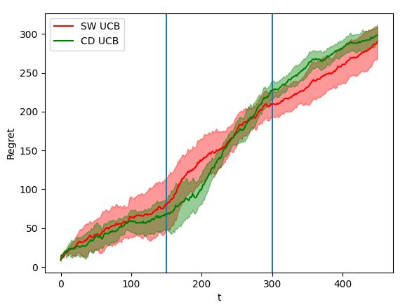
Results
Plot of the cumulative regret of CD UCB and SW UCB, in a time horizon of T = 450
Mean over 5 experiments
Since learners have to keep up with the changes, the cumulative regret is not stabilizing
Both the learners have a high regret, maybe the time horizon of 150 for each phase is too small

Slide 41
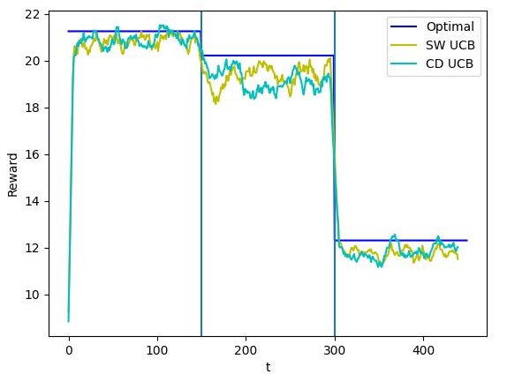
Results
Plot of the daily reward, according to the prices chosen by the algorithms, in a time horizon of T = 450
Mean over 5 experiments
In some phases the rewards achieve to converge to the computed optimal, while in others the optimal seems not to be reached in time
In the second phase it takes more time to converge because there's a major change in the configuration

Slide 42
Step 7: Context generation

Slide 43
Step 7
The step aims at optimizing the total reward by implementing TS and UCB algorithm for uncertain conversion rates, α ratios and number of sold items, knowing the features of the users
The time frame is 2 weeks

Slide 44
UCB
We associate every product with a UCB learner; every price corresponds to an arm
We estimate the conversion rate, computed as the weighted average of the ratio between buyers and viewers, and used this as the empirical mean
The steps are as follows:
  We compute the upper confidence as the sum of the empirical mean and the confidence, for each price, each day
  Select the arm that maximizes this value:
  Once the prices (arm) are selected we run the simulation with the configuration
  Then, the confidence is updated as follows:
  finally we updated the estimated number of sold items and alphas

Slide 45
TS
We associate every product with a TS learner; every price corresponds to an arm
We define beta parameters from a distribution, with their means being the estimated conversion rates
The steps are as follows:
  We draw a sample from a beta distribution (b) for each price, each day
  Select the arm that maximizes this value:
  Once the prices (arm) are selected we run the simulation with the configuration
  Then, the parameters of the beta are updated as follows:
  finally we updated the estimated number of sold items and alphas

Slide 46
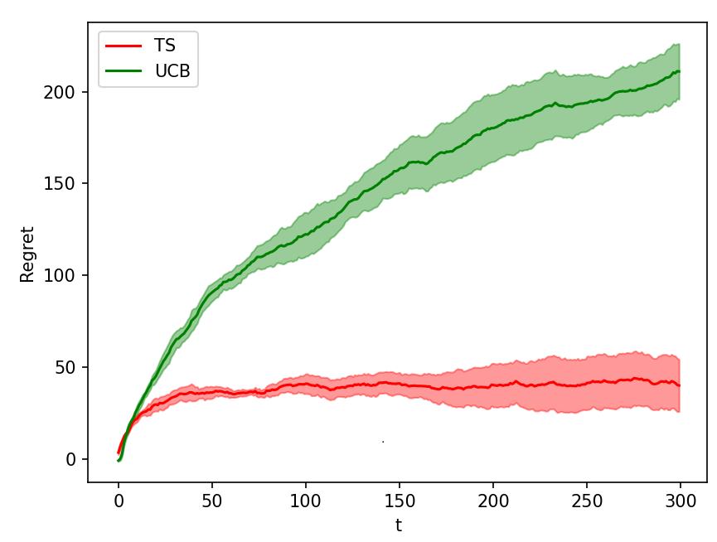
Results
Plot of the cumulative regret of TS and UCB, in a time horizon of T = 300
Mean over 5 experiments
TS behaves similarly to the other steps
UCB performs worse with respect to the previous steps

Slide 47
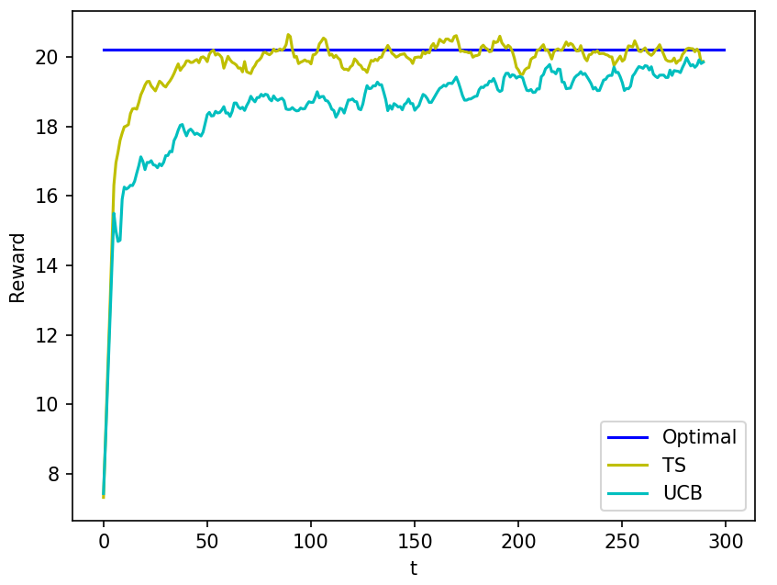
Results
Plot of the daily reward, according to the prices chosen by the algorithms, in a time horizon of T = 300
Mean over 5 experiments
TS reaches the optimal
UCB does not overcome the optimal reward in the chosen time horizon
… other comments?

Slide 48

Thank you!

